Slide 1

CS 533 INTRO TO DATA SCIENCE
Michael Ekstrand

Slide 2
DATES

Slide 3
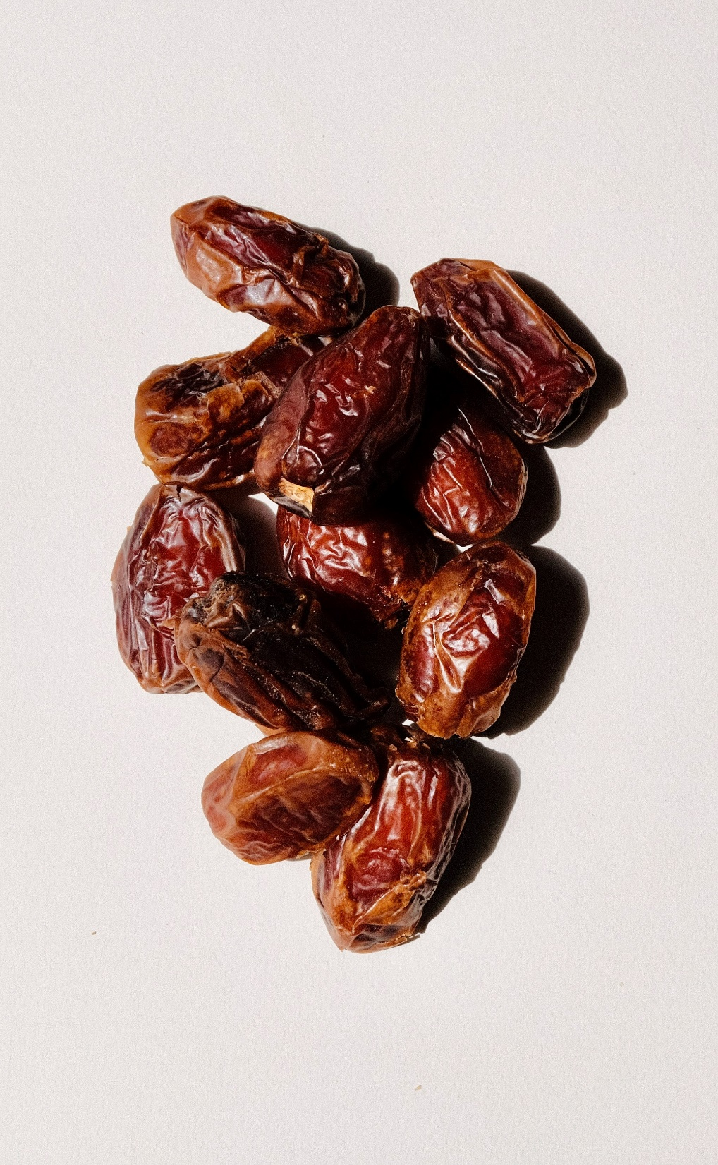
Learning Outcomes
Parse and transform dates
Adjust dates using date offsets
Photo by J. on Unsplash

Slide 4
Dates and Representations
Time moves forward at a constant rate (generally…)
How we record it changes
Daylight savings time – the same hour happens twice
Key insight: time is different from representation
Typically: store time in monotonic form, translate for presentation

Slide 5
Numeric Representations
Unix timestamps — time since (or before) midnight Jan 1, 1970
Seconds, milliseconds, nanoseconds
Reference point is UTC
Julian day numbers
Days since January 1, 4713 BC
Floating point stores time as fraction of a day
“1900 system” (Excel): days since Jan. 1, 1900

Slide 6
String Representations
ISO: 2020-11-03
Alphabetic sorts by date (for AD, until 10000)
Localized numeric
US: 11/03/2020
EU: 03/11/2020
Longer
November 3, 2020

Slide 7
datetime64
The Pandas datetime64 type stores dates (and times).
Construct from:
Number, units, and epoch
pd.to_datetime(230481083, unit='s') — seconds since Unix epoch
pd.to_datetime(3810401, unit='D', origin='julian') — days since Julian epoch
String and format
pd.to_datetime('2020-11-03') — convert from ISO
pd.to_datetime('Nov 3 2020', format='%b %d %Y')

Slide 8
timedelta
The Pandas timedelta type stores time offsets
Create from number + units or string
‘1 day 00:30:22’ – one day, 30 minutes, and 22 seconds
Mark advances in linear time

Slide 9
DateOffset
DateOffset type stores date offsets to adjust calendar days
Create from number + units
pd.DateOffset(months=240)
Correctly offset dates, even with underlying nonlinearities
Months don’t have the same length
DST, leap years, leap seconds
Not directly supported by Series
Can use in ‘apply’: month_series.apply(lambda m: pd.DateOffset(months=m))

Slide 10
Date Arithmetic
datetime + timedelta = datetime
datetime + DateOffset = datetime
DateOffset * num = DateOffset

Slide 11
Comparisons
DateTime supports comparison operators (==, <, etc.)
Need to create DateTimes on both sides

Slide 12

Wrapping Up
Dates and times are typically stored internally using offsets from an origin.
Pandas provides several date and time features, including datetime, timedelta, and DateOffset.
Photo by Bundo Kim on Unsplash

